Slide 1

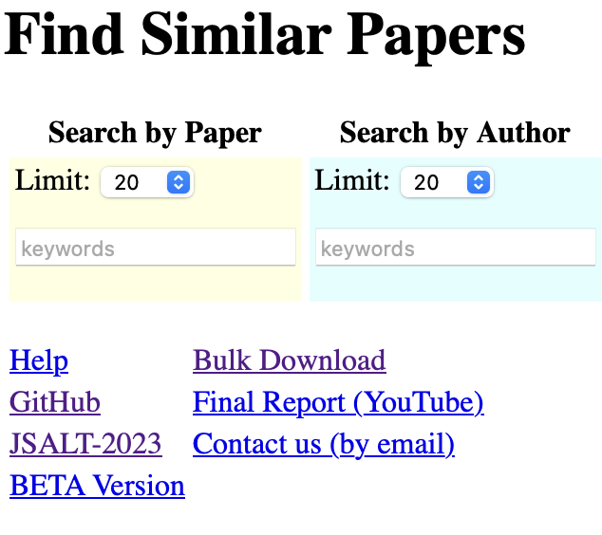
Use-Driven Research
Bangor Savings Bank
AI Solutions Hub:
Bangor Savings Bank
Research:
Better Together
Academic Search
http://recommendpapers.xyz

Slide 2
Stuff I had planned to talk about
Is Peer-Reviewing Worth the Effort?
https://aclanthology.org/2025.coling-main.242/
I have complained about reviewing in the past
But this time, we offer a constructive proposal to address challenges (scale)
Too many submissions / Too few qualified reviewers
Indonesian (and collaboration with Singapore)
Sam asked me to talk about https://huggingface.co/blog/open-r1
Data Centers (clouds) are so last century
Sharing is more expensive than commodity hardware
Moved http://recommendpapers.xyz from AWS to a commodity box in my house
Lesson Learned: Edge is Cheaper, Bigger and Better
Cheaper: $700 (no monthly bills)
Bigger: 24 TBs (with option to expand @ $10/TB)
Better: It is all mine (no need to share; no tickets)
GPUs are coming to a home/phone near you

Slide 3
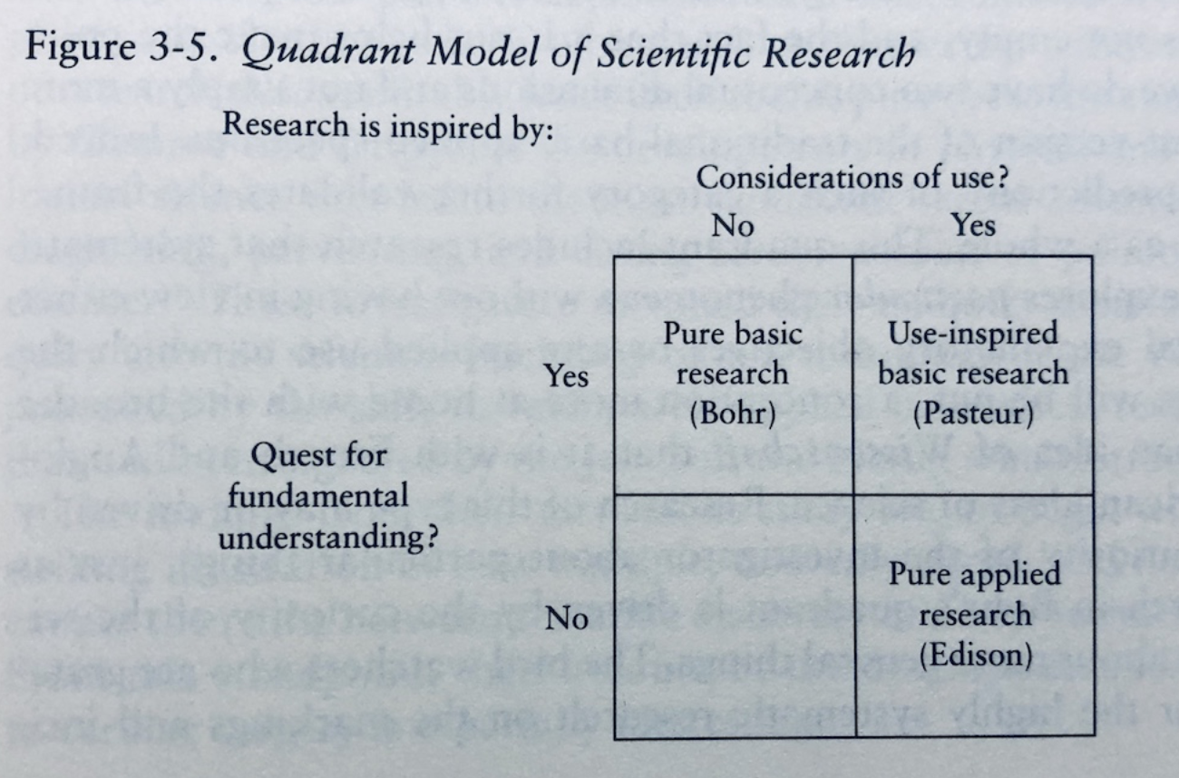
Use-Driven Research
We are here

Slide 4
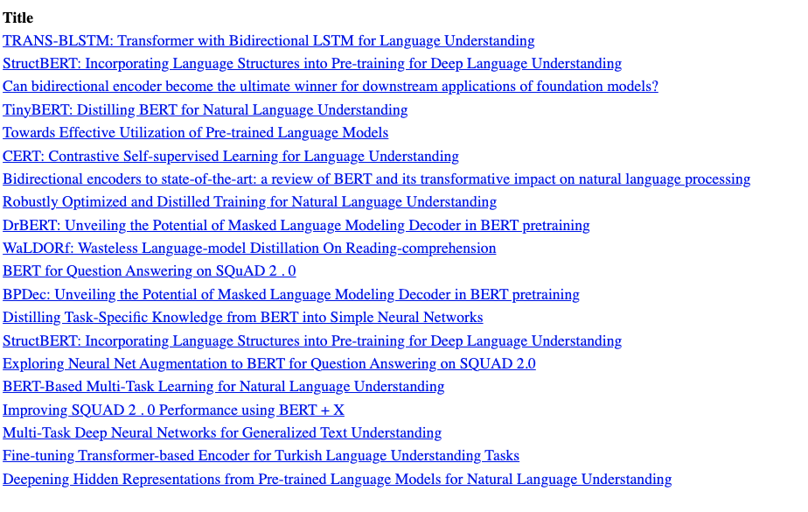
Recommendations: Query: BERT paper
http://recommendpapers.xyz

Slide 5
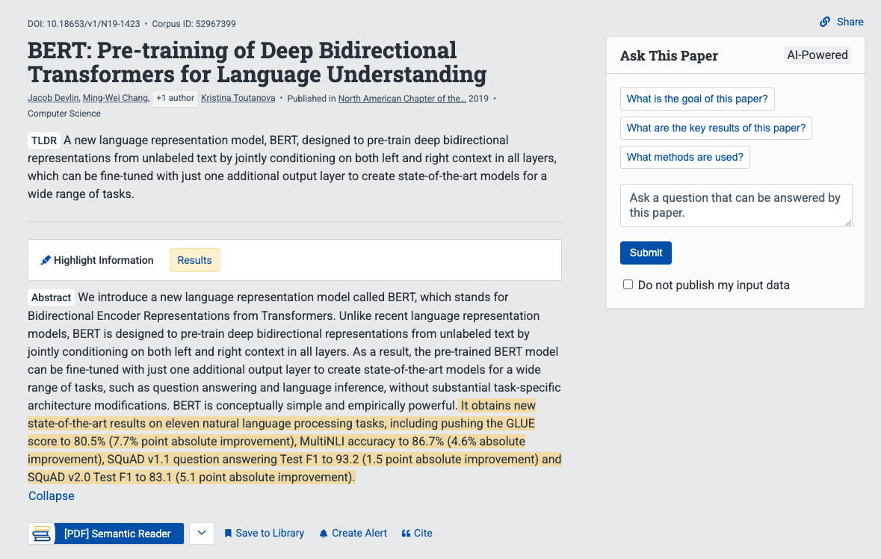
Snippet from Semantic Scholar
chat

Slide 6
What do I really want to ask this paper?
How does this paper compare with that paper?
What do they have in common?
How do they differ?
Similarities
Both BERT and TinyBERT use similar methods (transformers)
to encode text as vectors
Differences
TinyBERT is smaller, faster, cheaper
and almost as good

Slide 7
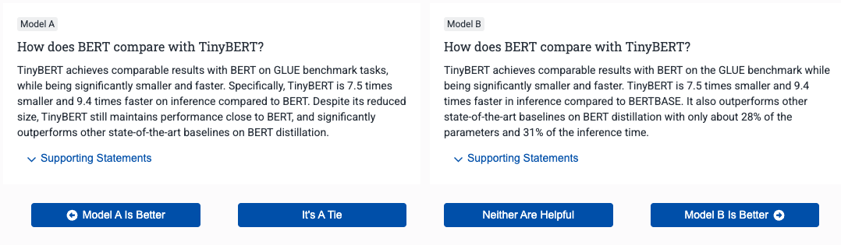
How does BERT compare with TinyBERT?
Too many details
Similarities
Both BERT and TinyBERT use similar methods (transformers) to encode text as vectors
Differences
TinyBERT is smaller, faster, cheaper and almost as good

Slide 8
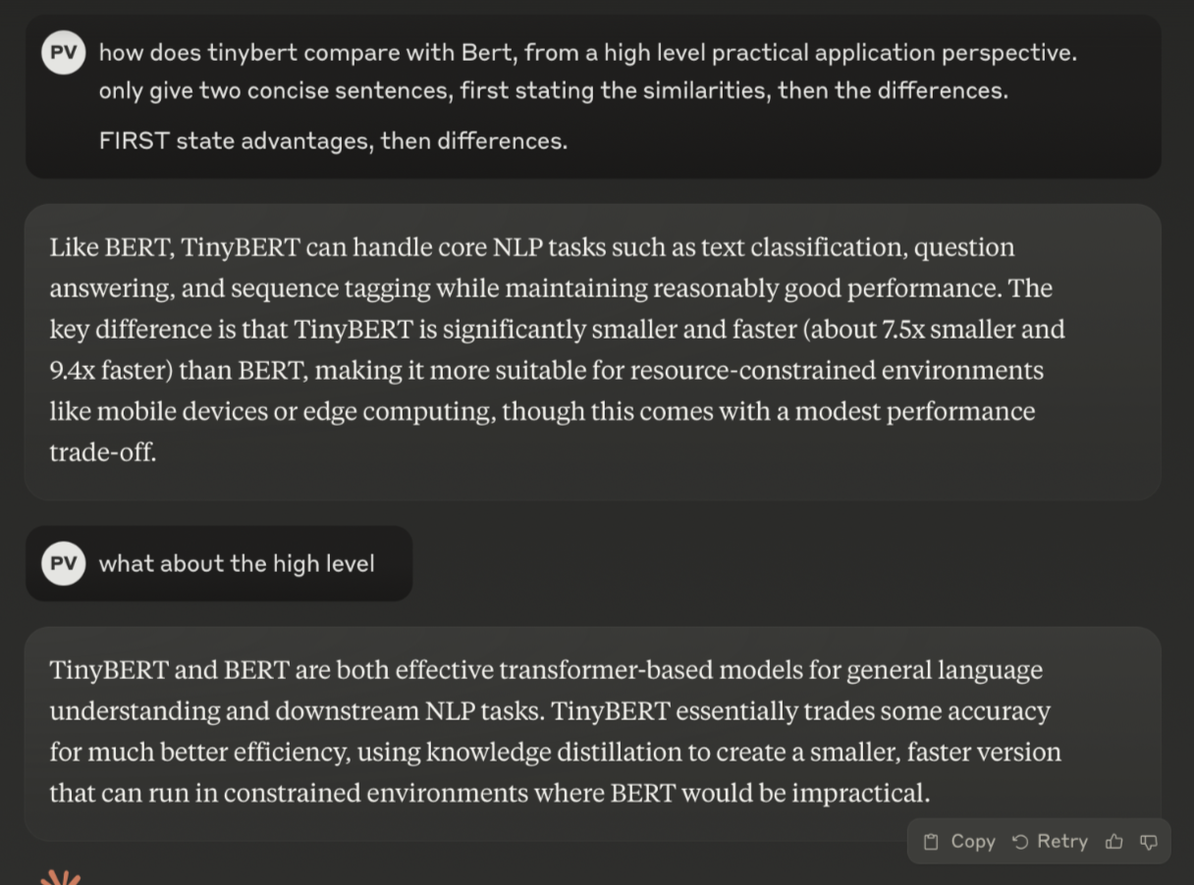
How does BERT compare with TinyBERT?
Peter Vickers
Similarities
Both BERT and TinyBERT use similar methods (transformers) to encode text as vectors
Differences
TinyBERT is smaller, faster, cheaper and almost as good

Slide 9
How did Peter do what he did?
Based on experience
Gained from Bangor Saving Bank engagement
Key Insight
Bots return too many details on first iteration
But less so on second iteration

Slide 10
Bangor Savings Bank Example
Task: Describe Customer Segment
Inputs: Statistics for Segment A
Income: $120k avg
Credit score: 750+
Monthly spend: $3000+
Travel: 40% of spend
Output (too many details on 1st iteration):
This customer segment consists of affluent professionals with excellent credit history who demonstrate consistent high-value spending patterns, particularly in travel-related purchases, indicating a preference for premium travel rewards cards...

Slide 11
Lesson Learned from Bangor Savings Bank
1st Iteration (too many details)
2nd Iteration (better: less is more)
This customer segment consists of affluent professionals with excellent credit history who demonstrate consistent high-value spending patterns, particularly in travel-related purchases, indicating a preference for premium travel rewards cards...
Frequent traveling professionals with high income and excellent credit

Slide 12
TinyBERT Example: Summary of Summary → More High Level
1st Iteration:
Prompt LLM for summary
2nd Iteration:
Prompt LLM for summary of previous summary

Slide 13
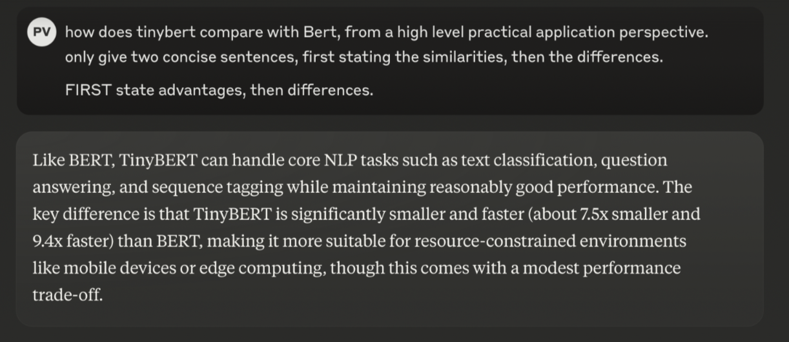
TinyBERT Example: 1st Try (too detailed)

Slide 14
Summary of Summary → More High Level
1st Iteration
2nd Iteration
Similarities
Both BERT and TinyBERT use similar methods (transformers) to encode text as vectors
Differences
TinyBERT is smaller, faster, cheaper and almost as good

Slide 15
Many more opportunities…
Evity/RAG Evaluation:
Existing RAG evaluation frameworks fail with instruction-giving tasks
Zotero/Question Deduplication:
How do we know how many unique questions are being asked in a forum?
Bangor Savings Bank/Document Parsing:
How can we detect when required information is in figures?

Slide 16
Conclusions
We are here

Slide 17
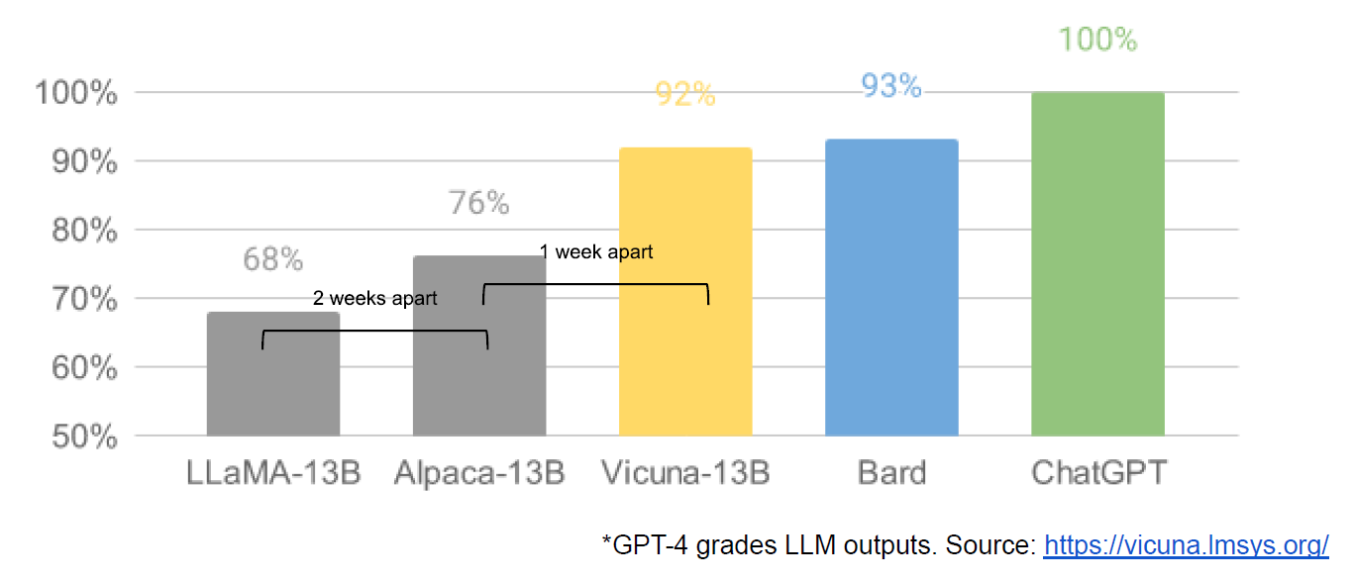

Deep Seek: Open/Closed
https://huggingface.co/blog/open-r1
Google (2020s) “We Have No Moat, And Neither Does OpenAI”
https://semianalysis.com/2023/05/04/google-we-have-no-moat-and-neither/
Microsoft (2000s):
How can we sell Windows when Linux is free?
At Bell Labs (1990s):
Unix business couldn’t imagine that Stallman could compete with them,
but I wasn’t so sure (I knew Stallman at MIT in 1970s)
The Bomb: Classify it (or share for treaties)
NVIDIA: Protect it (= blow it up)

Slide 18
Deep Seek: Economies of Scale (?)
Big companies are betting on bigger models
Bigger models are better (on many benchmarks)
Bigger: parameters, data, cost
But TinyBERT is smaller, faster, cheaper
and almost as good
There have to be lots of ways to do almost as well…
Big capital-intensive investments:
Assets or Liabilities?

Slide 19
Diseconomy of Scale (from 1980s)
Thinking Machines
Though they were competing with Cray (supercomputers)
But they were losing to PCs (less than a minicomputer)
Danny Hillis (classmate of mine and student of Minsky)
discovered smaller computers (PCs) are faster, cheaper and better
than supercomputers
I asked economists at Bell Labs about this and they responded:
Scale:
Size of market
Not size of computer
Lesson for today:
Phones will be faster, cheaper and better than data centers
in terms of crunch per dollar

Slide 20
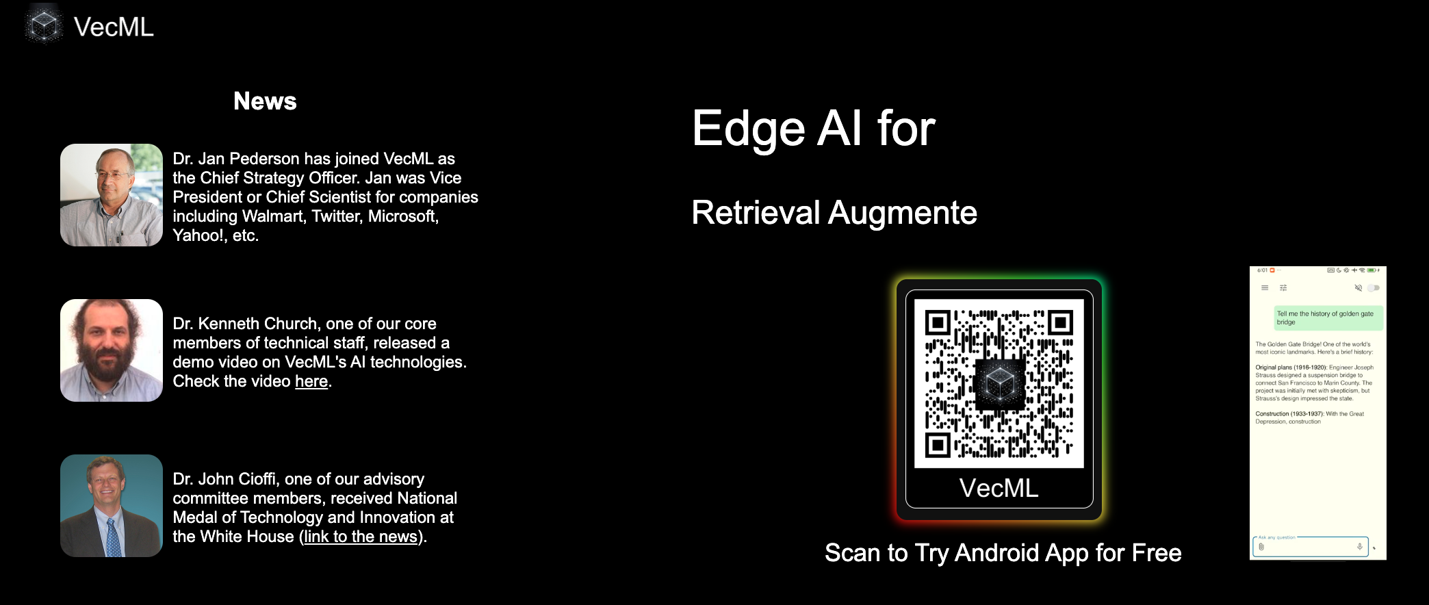

Slide 21
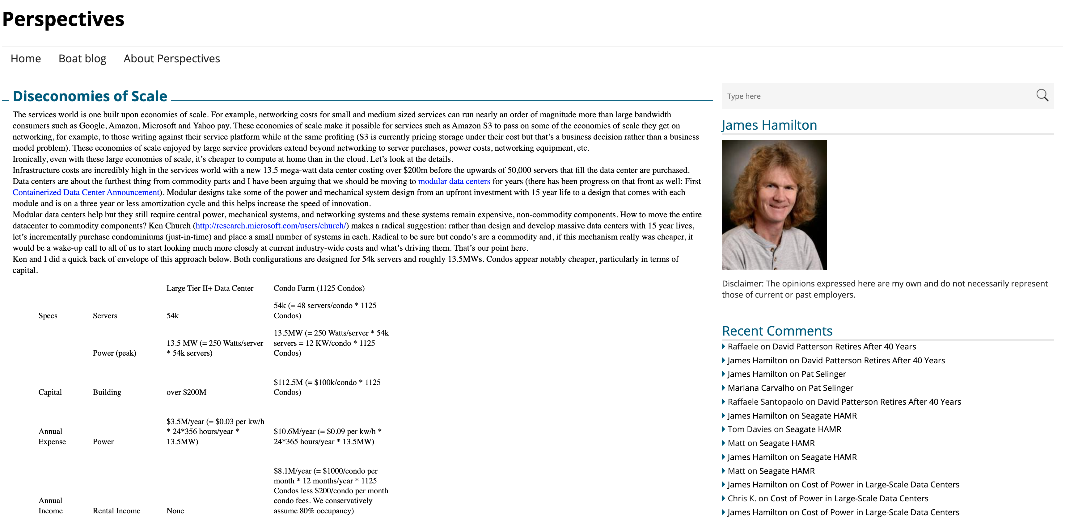

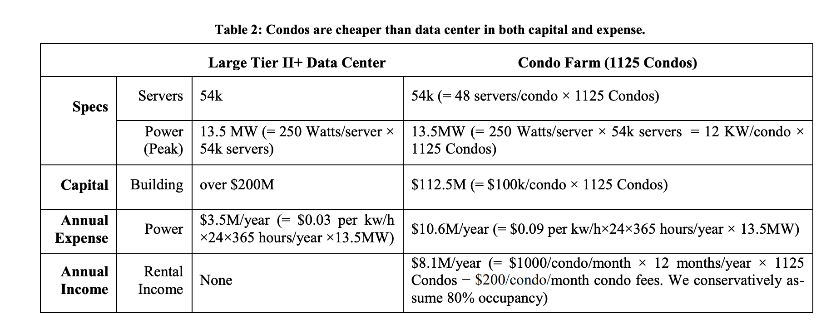
https://perspectives.mvdirona.com/2008/04/diseconomies-of-scale/

Slide 22
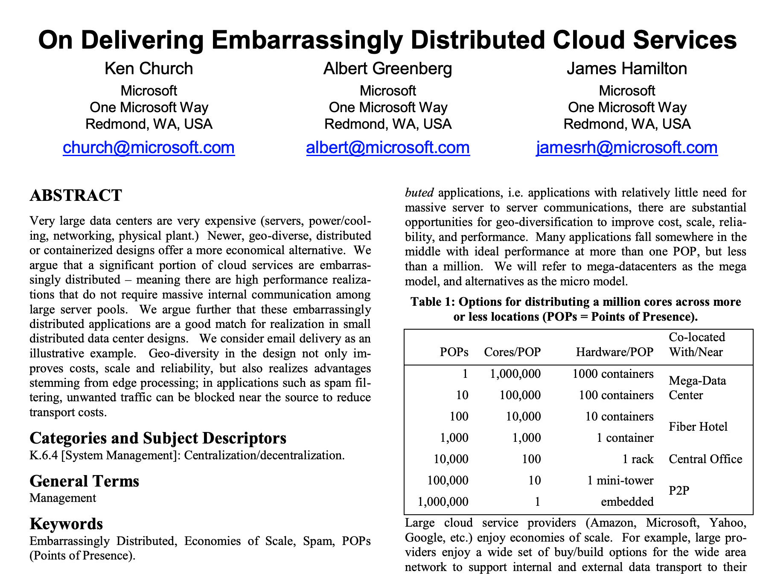
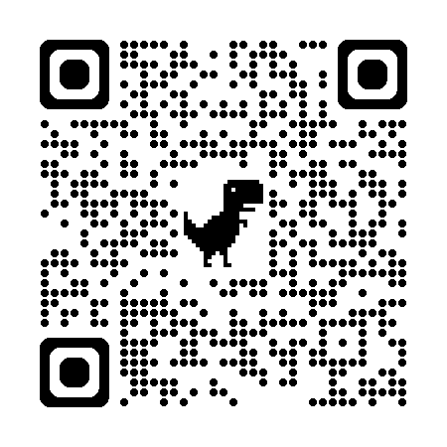

Slide 23
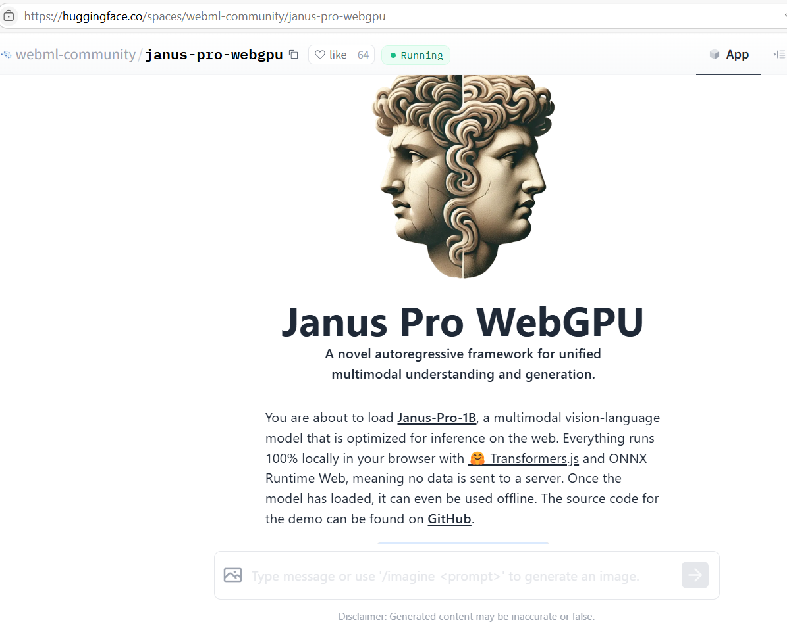
DeepSeek drop of Janus Pro, a multimodal LM yesterday Demo on HF, 1B model, runs in browser

Slide 24
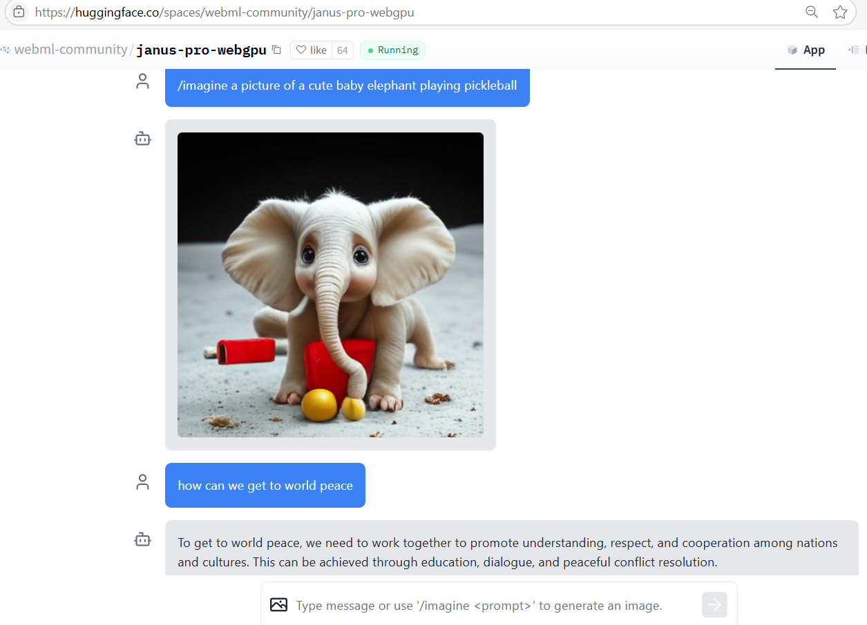
Not quite
pickle-ball… but cute elephant! Expected more of a 1B model, but will improve, presumably.

